Slide 1

CS 533 INTRO TO DATA SCIENCE
Michael Ekstrand

Slide 2
DESCRIPTIVE STATISTICS

Slide 3
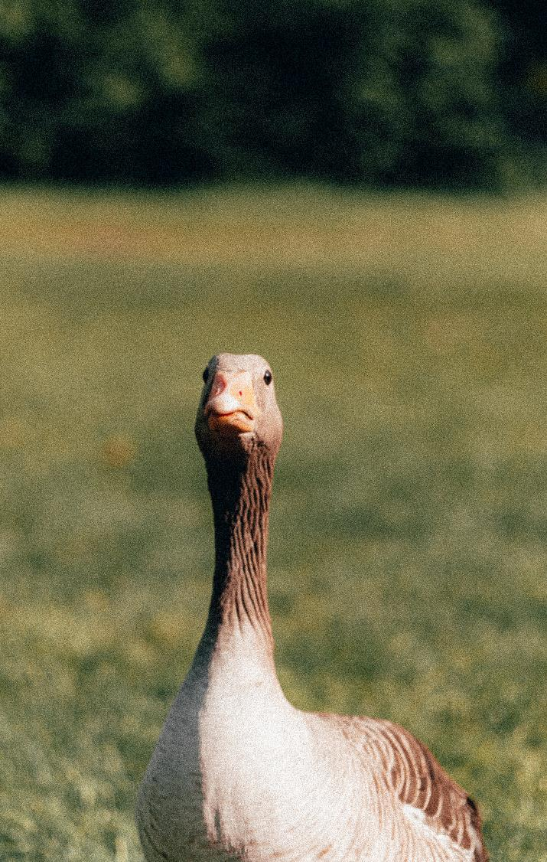
Learning Outcomes
Know what a statistic is
Identify whether a mean or a median is more appropriate
Describe the central tendency and spread of a data series
Photo by Fabio Santaniello Bruun on Unsplash

Slide 4
Statistic
A statistic is a value computed from a collection of data
Often summarizes (observations of) a variable

Slide 5
Descriptive Questions
Where is the variable centered?
How large does it tend to be?
Called meaure of central tendency
How spread out is it?

Slide 6
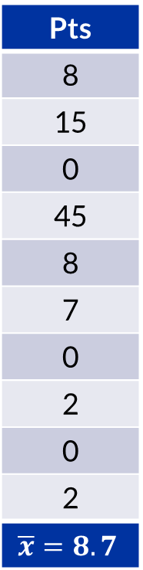
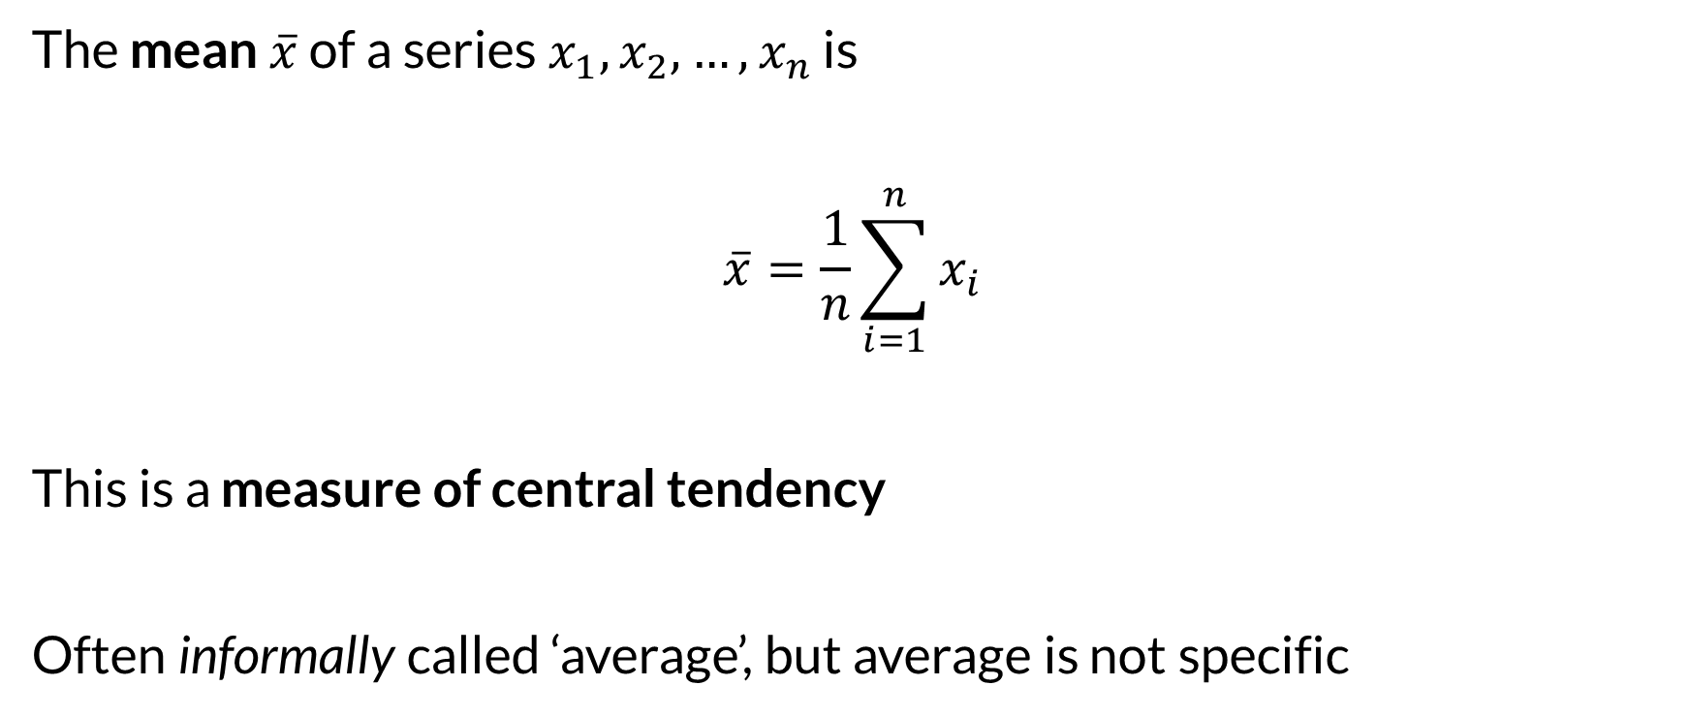
Mean
Pts
8
15
0
45
8
7
0
2
0
2
$$\overline{x}=8.7$$
The mean $\overline{x}$ of a series $x_{1},x_{2}, …,x_{n}$ is
$$\overline{x}=\frac{1}{n}\sum_{i=1}^{n}{x_{i}}$$
This is a measure of central tendency
Often informally called ‘average’, but average is not specific

Slide 7
What is a Mean?
What does the mean measure?
If every instance had the same value, what would it be?
“Points per player”
How do you change it?
Increase total (score more points)
It doesn’t matter where – one person can do all of it!

Slide 8
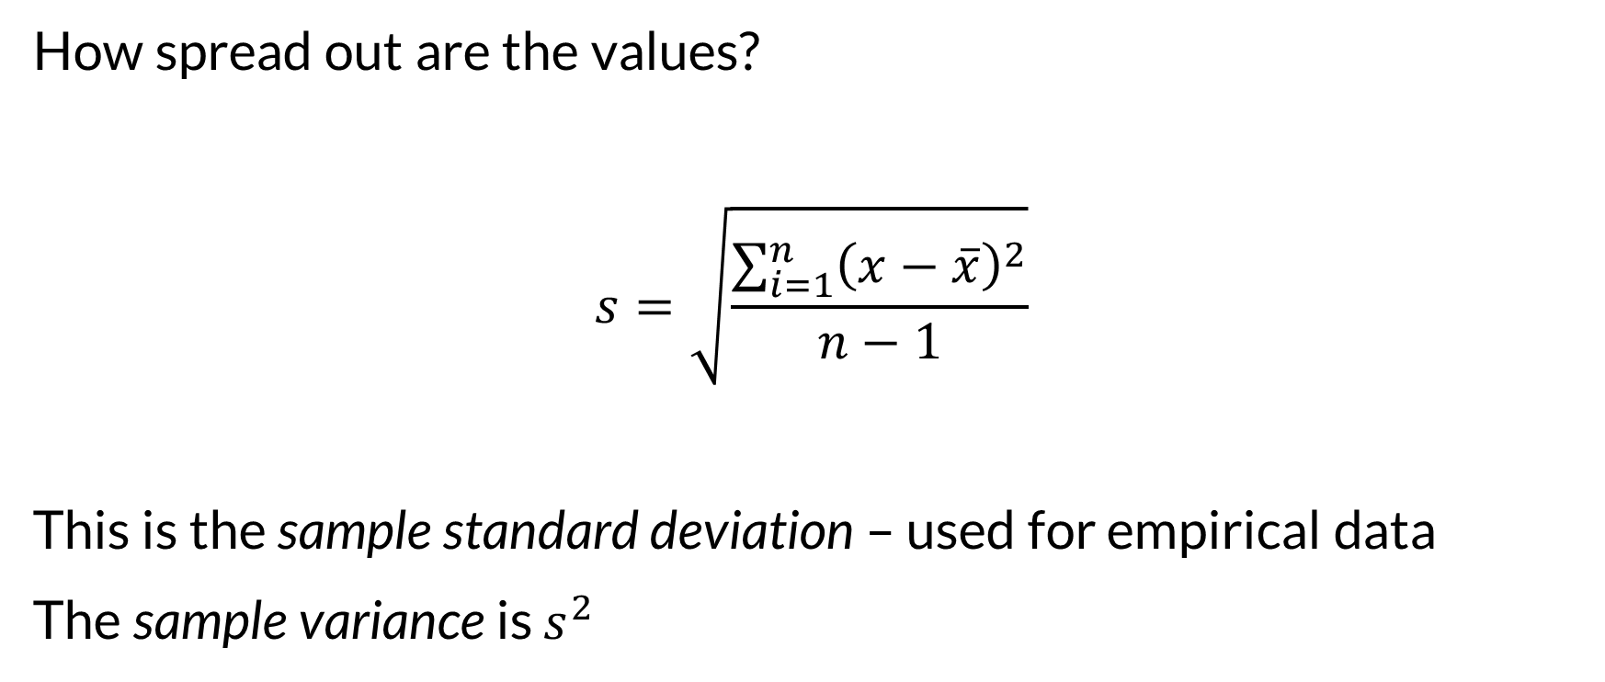
Spread - Variance and Standard Deviation
How spread out are the values?
$$s=\sqrt{\frac{\sum_{i=1}^{n}{{\left(x−\overline{x}\right)}^{2}}}{n−1}}$$
This is the sample standard deviation – used for empirical data
The sample variance is $s^{2}$

Slide 9

What is Variance?
What does variance measure?
The mean squared distance from the mean
If mean is center, how far away do values tend to be?
If mean is expectation, how far off does it tend to be?
Square penalizes large differences more
Standard deviation translates back to original units

Slide 10
Computing Statistics
Pandas:
Series.mean()
Series.std()
Series.var()
Note: np.std and np.var compute population std and var, not sample
Change with ddof=1

Slide 11

Outliers
Outliers are particularly large or small values
Outliers draw the mean towards them! (also affect SD)

Slide 12
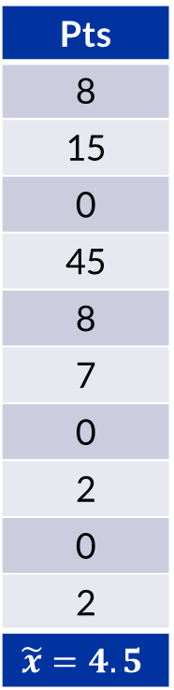
Median
Pts
8
15
0
45
8
7
0
2
0
2
$$\tilde{x}=4.5$$
What value divides upper half from lower half?
Sort values
Pick middle one
If even number: take mean of middle 2
0 0 0 2 2 7 8 8 15 45
How to increase? Increase small values.

Slide 13
Spread – Range and IQR
The range is max – min
The inter-quartile range is distance between 1st and 3rd quartiles (width of “middle 50%”)
0 0 0 2 2 | 7 8 8 15 45

Slide 14
Quick Summary
>>> movie_info['count'].describe() count 59047.000000 mean 423.393144 std 2477.885821 min 1.000000 25% 2.000000 50% 6.000000 75% 36.000000 max 81491.000000 Name: count, dtype: float64

Slide 15
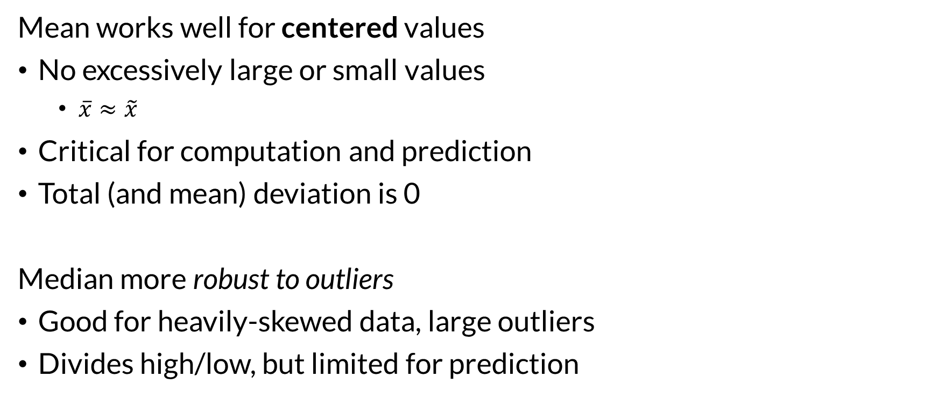
Mean, Median, and Skew
Mean works well for centered values
No excessively large or small values
$\overline{x}≈\tilde{x}$
Critical for computation and prediction
Total (and mean) deviation is 0
Median more robust to outliers
Good for heavily-skewed data, large outliers
Divides high/low, but limited for prediction

Slide 16
What question do we want to answer?
If we distributed the points equally, how many would each have?
If we randomly selected a player, are they equally likely to have more or less points?

Slide 17
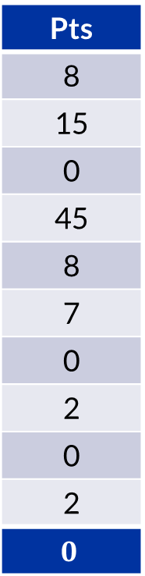
Mode
Pts
8
15
0
45
8
7
0
2
0
2
$$0$$
The most common value
doesn’t work great for continuous values
fantastic for categorical variables!

Slide 18

Wrapping Up
Mean and median describe where a value tends to be.
Standard deviation, variance, range, and IQR measure how spread out it is.
Mean-based computationally useful; median-based robust to outliers.
Photo by Brylee Hawkins on Unsplash

